Slide 1

Battle of the Neighborhoods
Coffee Shop in Vancouver, BC, Canada
Author: Rafael Vidigal de Moraes
Date: April 25th, 2021

Slide 2
Introduction
Open a new Coffee Shop in the city of Vancouver
Crime is a distress to people.
People who are willing to open a commercial establishments always take that information in consideration to open a new venue.

Slide 3
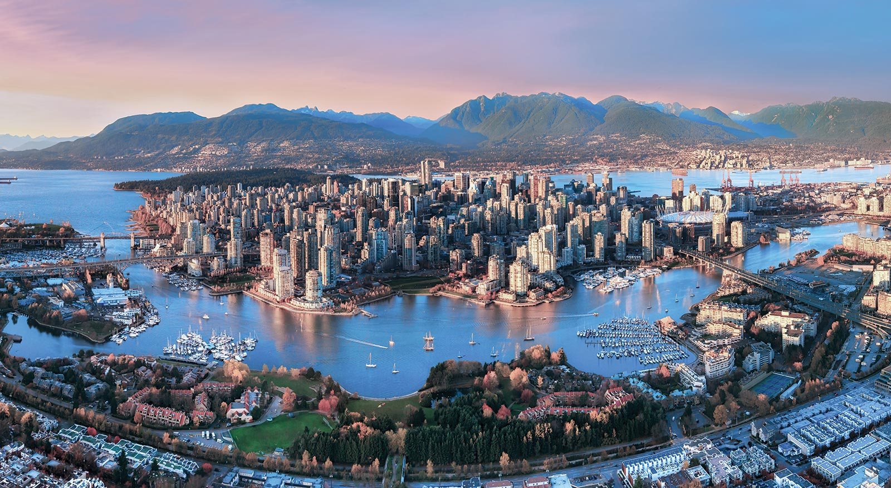
Geographical Location

Slide 4
Problem
Find a safe Borough to open a Coffee Shop in Vancouver;

Slide 5
Data
Vancouver Crime Data;
Vancouver Population per Neighborhood;
List of Borough;
Foursquare API;
GeoCoder.

Slide 6
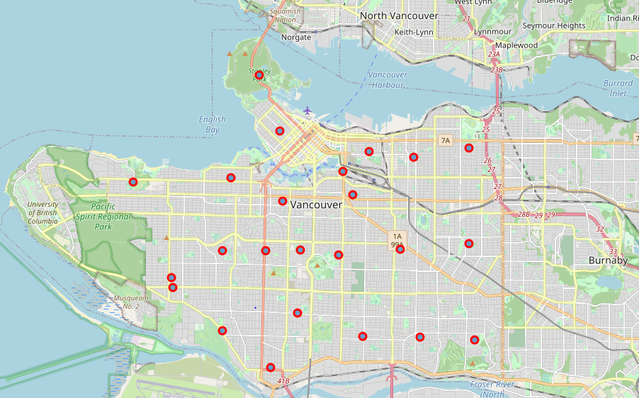
Neighborhood

Slide 7
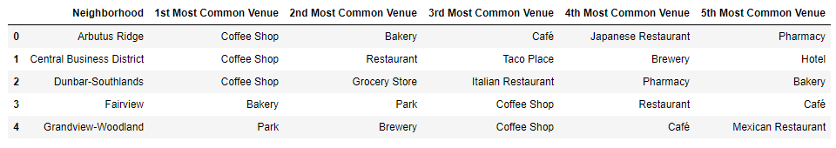
Top 5 Venue

Slide 8
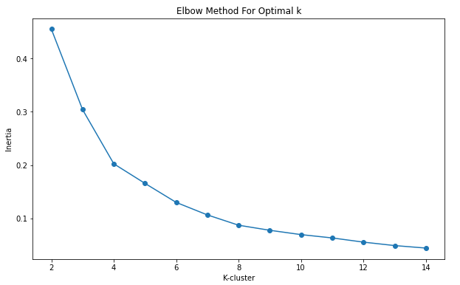
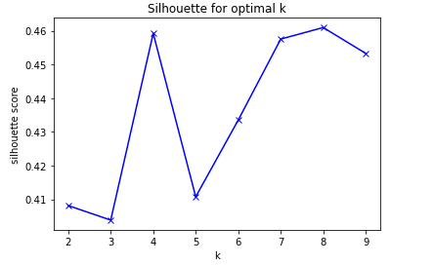
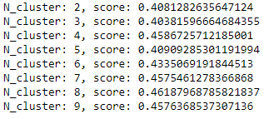
Cluster Analysis

Slide 9
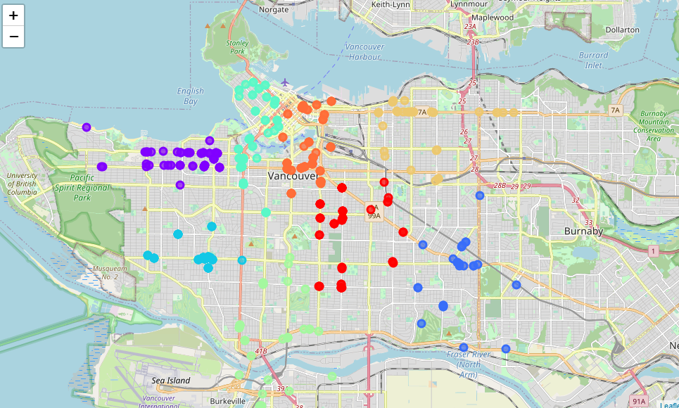
Clusters

Slide 10
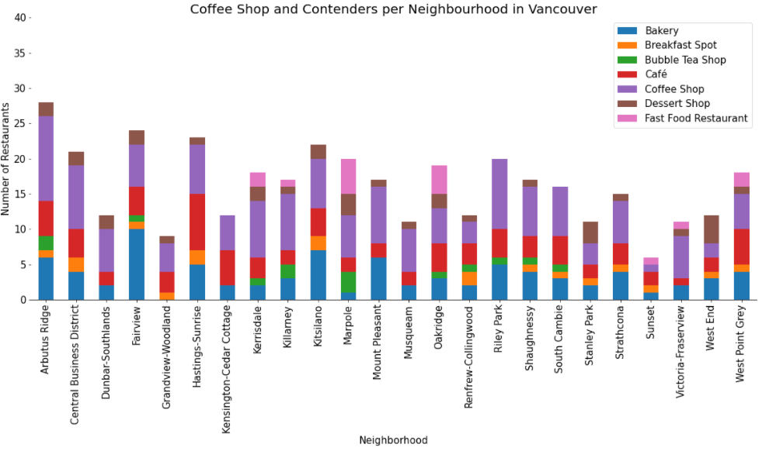
Coffee Shop and its Competitors

Slide 11
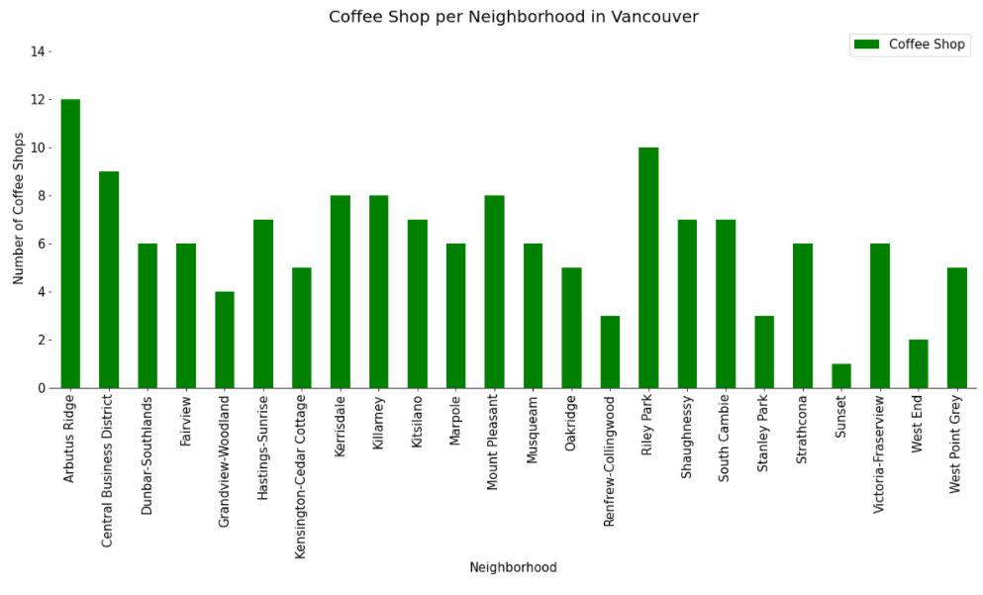
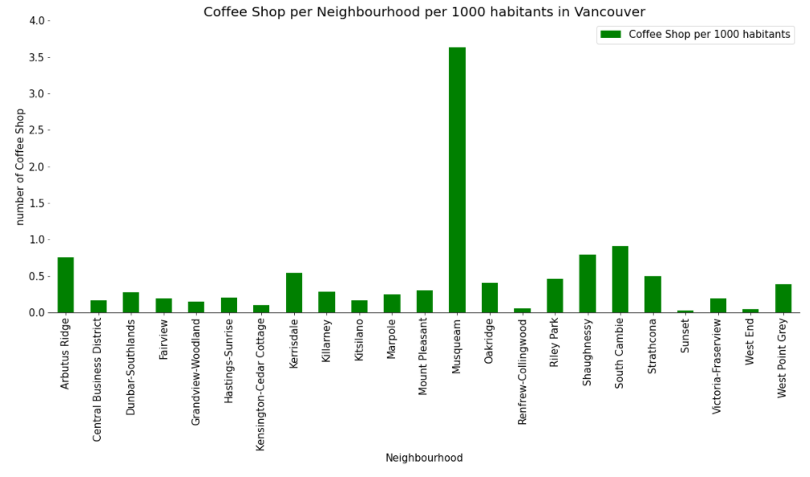
Coffee Shop Per Neighborhood

Slide 12
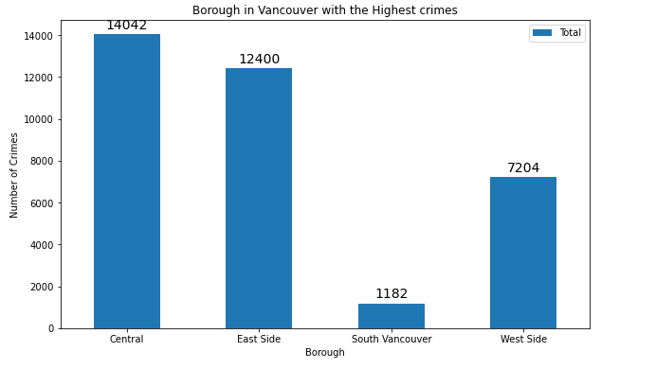
Crimes per Borough

Slide 13
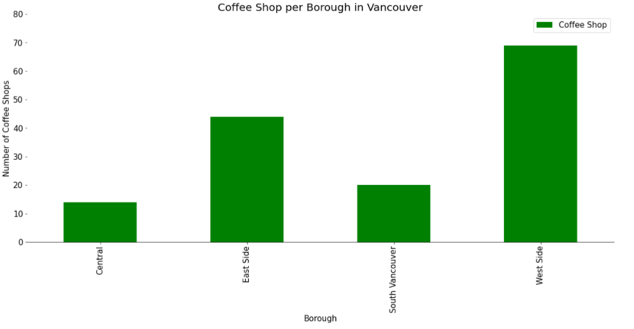
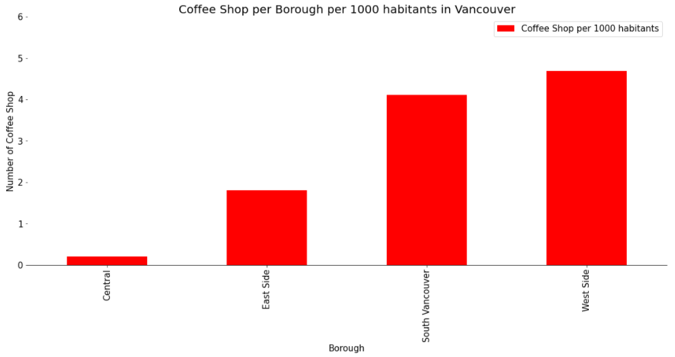
Coffee Shop Per Borough

Slide 14
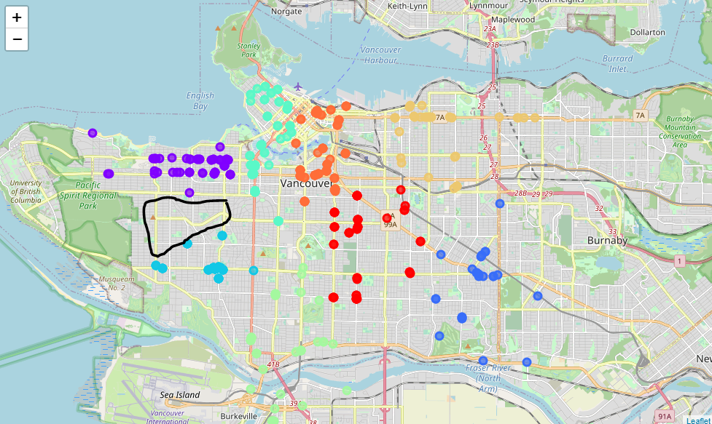
Conclusion

